Slide 1
Web Basics - JavaScript

Slide 2
Introduction to JavaScript
Basic Concepts of JavaScript
Embedding JavaScript in HTML

Slide 3
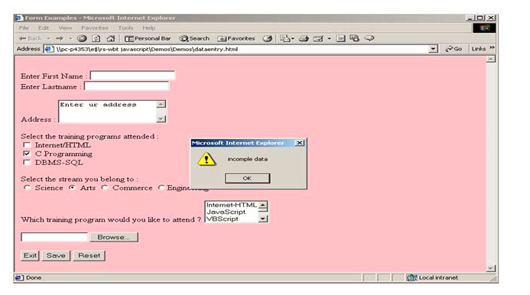
Basic Concept of JavaScript
JavaScript is the scripting language of the Web
JavaScript is used dynamic content into HTML page and for client side validation

Slide 4
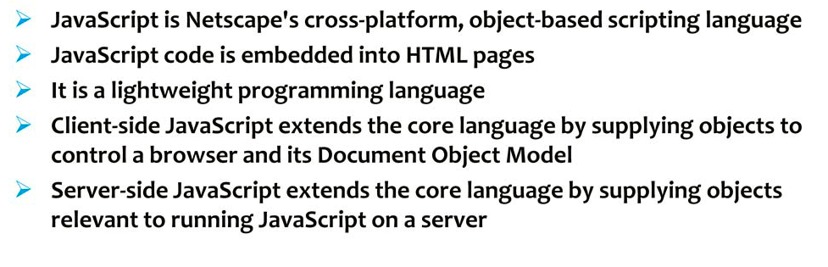
Overview

Slide 5
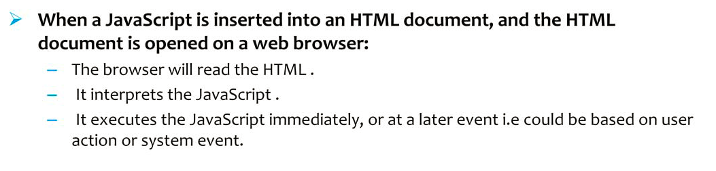
How does it work ?

Slide 6
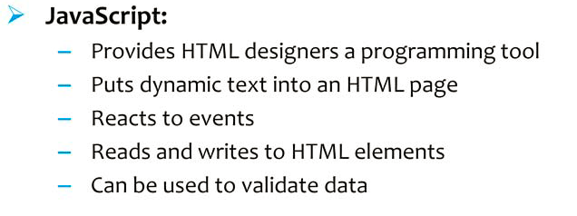
Why use JavaScript?

Slide 7
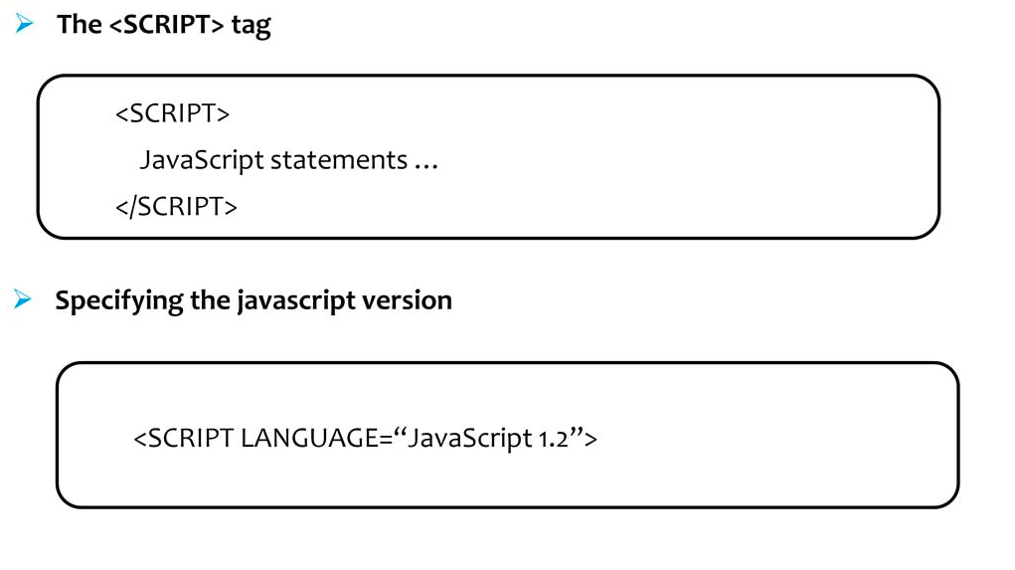
Embedding JavaScript in HTML

Slide 8
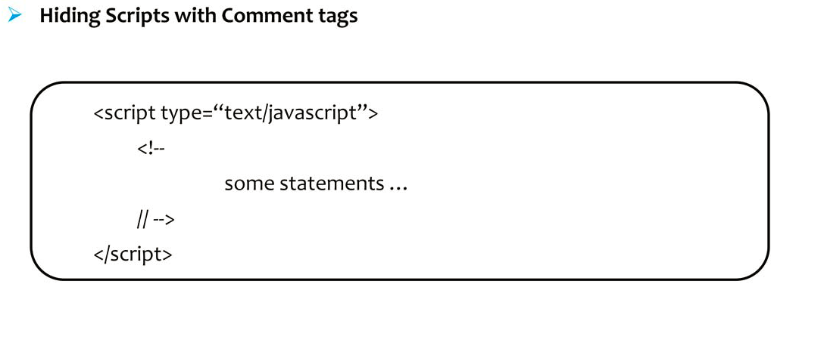
Embedding JavaScript in HTML (contd)

Slide 9
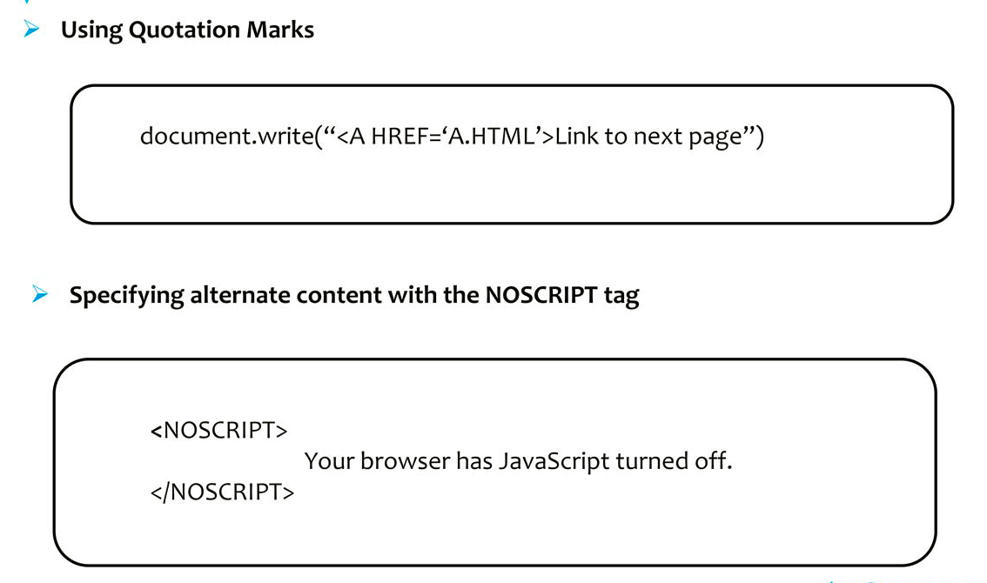
Embedding JavaScript in HTML (contd)

Slide 10
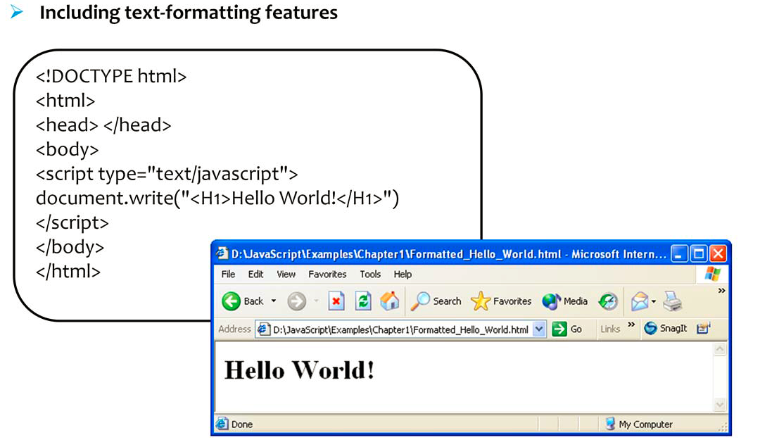
Embedding JavaScript in HTML (contd)

Slide 11
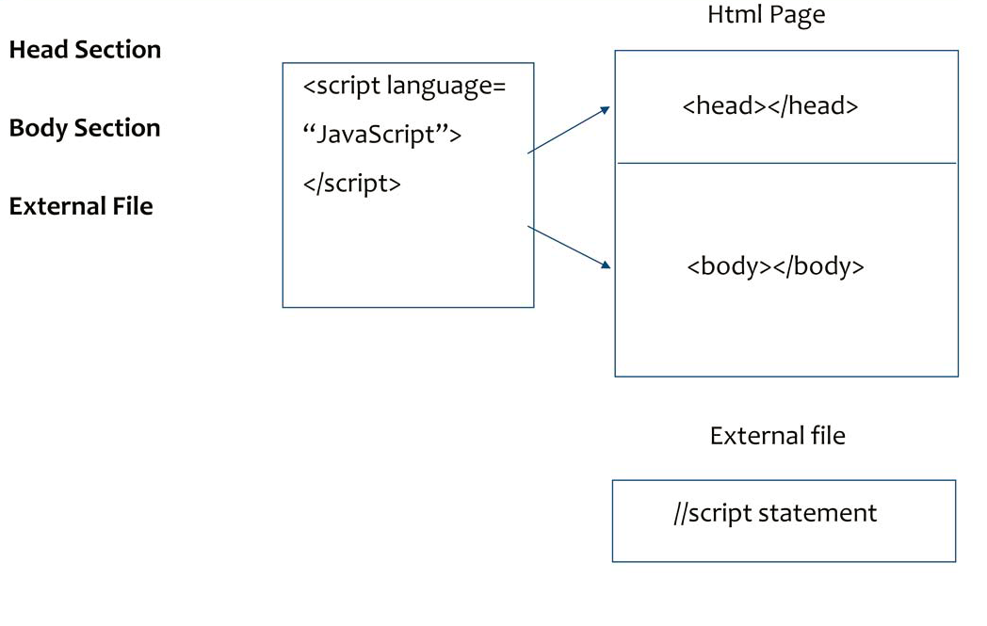
Where to write JavaScript?

Slide 12
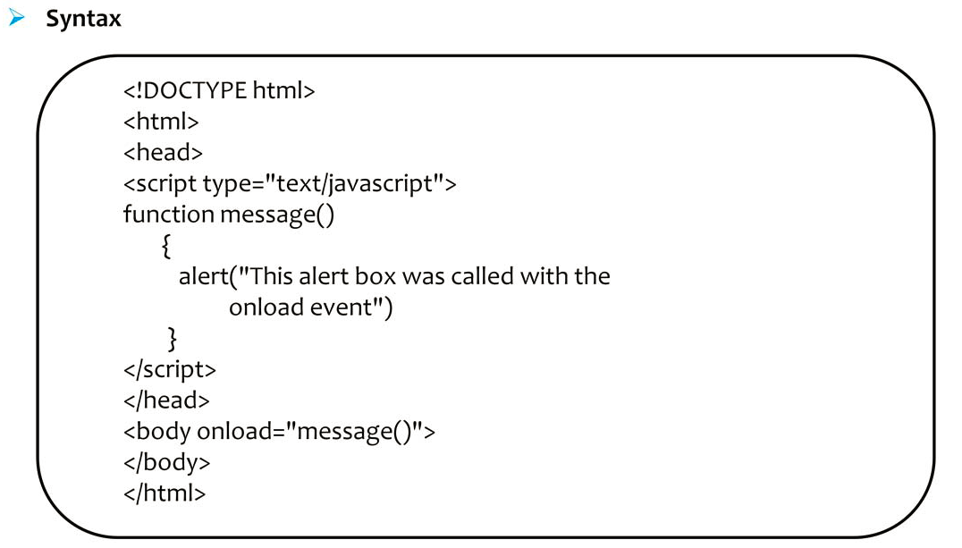
JavaScript in Head Section

Slide 13
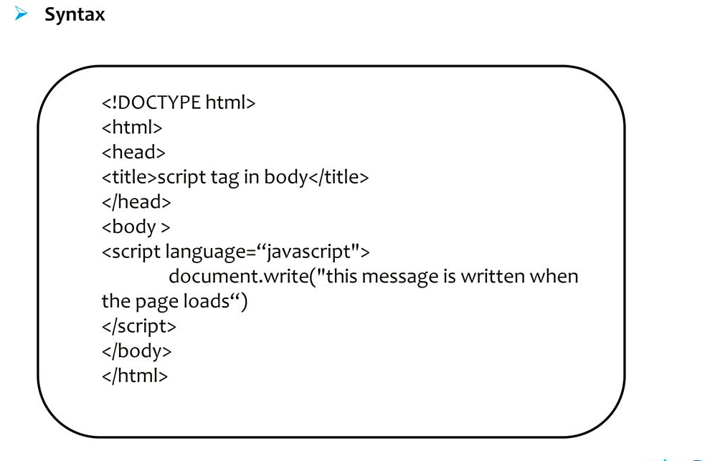
JavaScript in Body Section

Slide 14
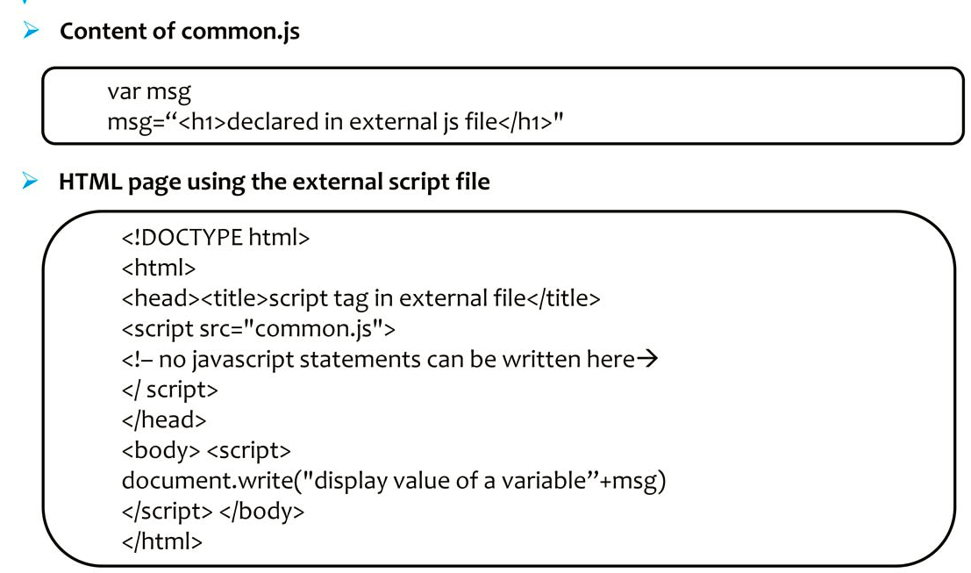
JavaScript in External File

